Slide 1




APPLICATION OF
PULSE WIDTH MODULATION
GROUP
6
Notes:
Duy - slide 1, 2, 3, 4, 5
Khanh - slide 6, 7
An - Phan con lai

Slide 2


1
Introduction
TABLE OF
CONTENT
2
Definitions
3
Application of PWM
4
Implementation
5
Result

Slide 3
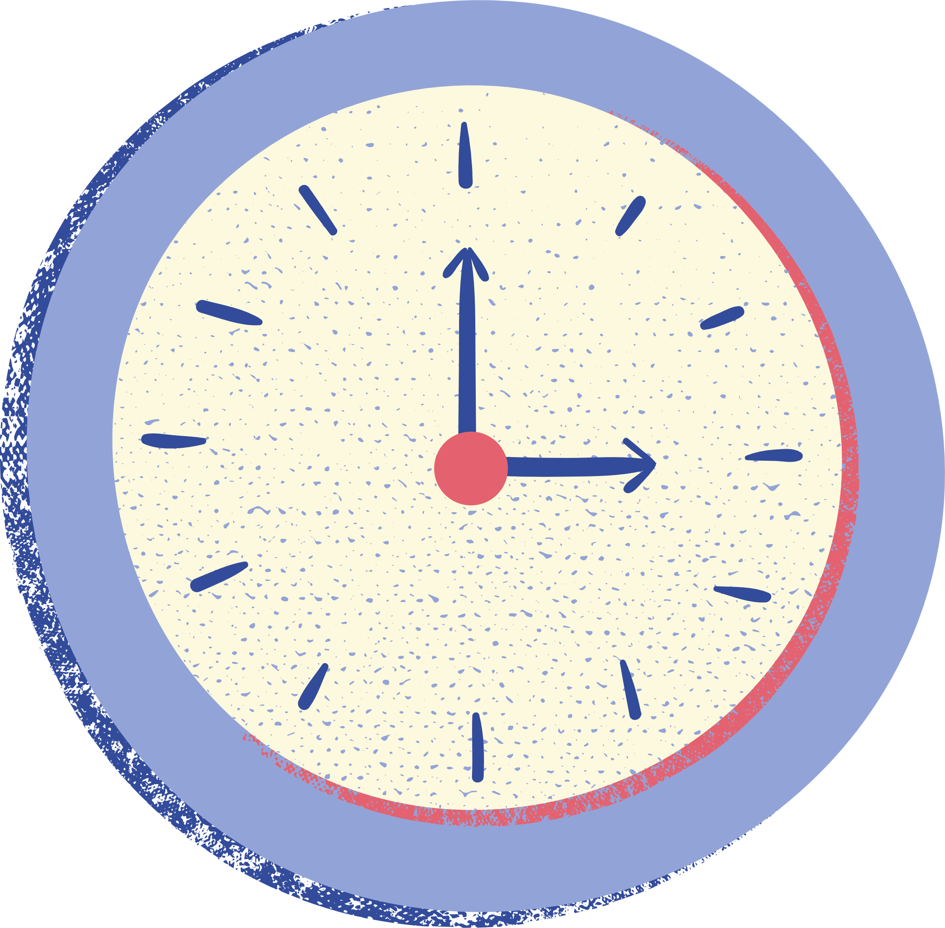





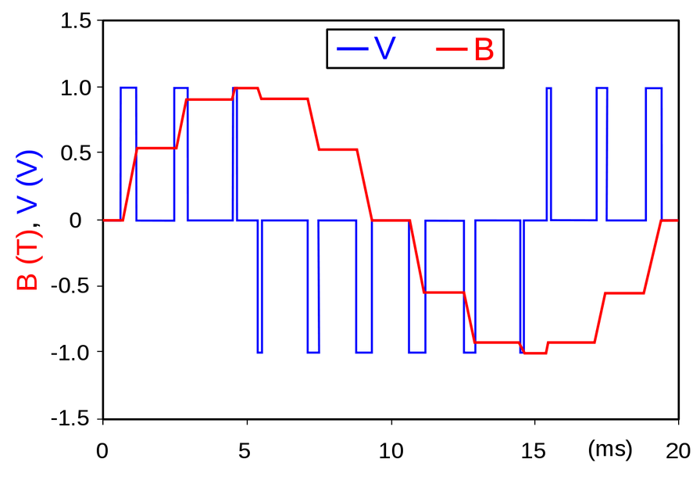

INTRODUCTION
In the last two decades, the Pulse width modulation (PWM) techniques have been extensively used for controlling analog circuitry. It is more commonly used for controlling the power converters employed in various industrial/domestic applications. In power converters it is used for firing of power electronic devices like thyristors, Insulated-Gate Bipolar Transistors (IGBTS), Metal Oxide Semiconductor Field Effect Transistors (MOSFET) etc.

Slide 4
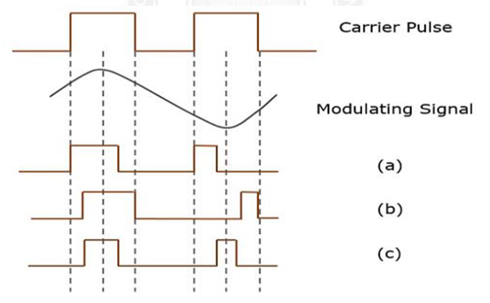


WHAT IS PWM?
Pulse Width Modulation (PWM) is an analog modulating scheme in which the duration or width or time of the pulse carrier varies proportional to the instantaneous amplitude of the message signal.
The width of the pulse varies in this method, but the amplitude of the signal stays constant. Amplitude limiters are used to make the amplitude of the signal constant. These circuits clip off the amplitude, to a desired level and hence the noise is limited. The following figures explain the types of Pulse Width Modulations (Figure 1)
Figure 1
PWM with different time slots

Slide 5
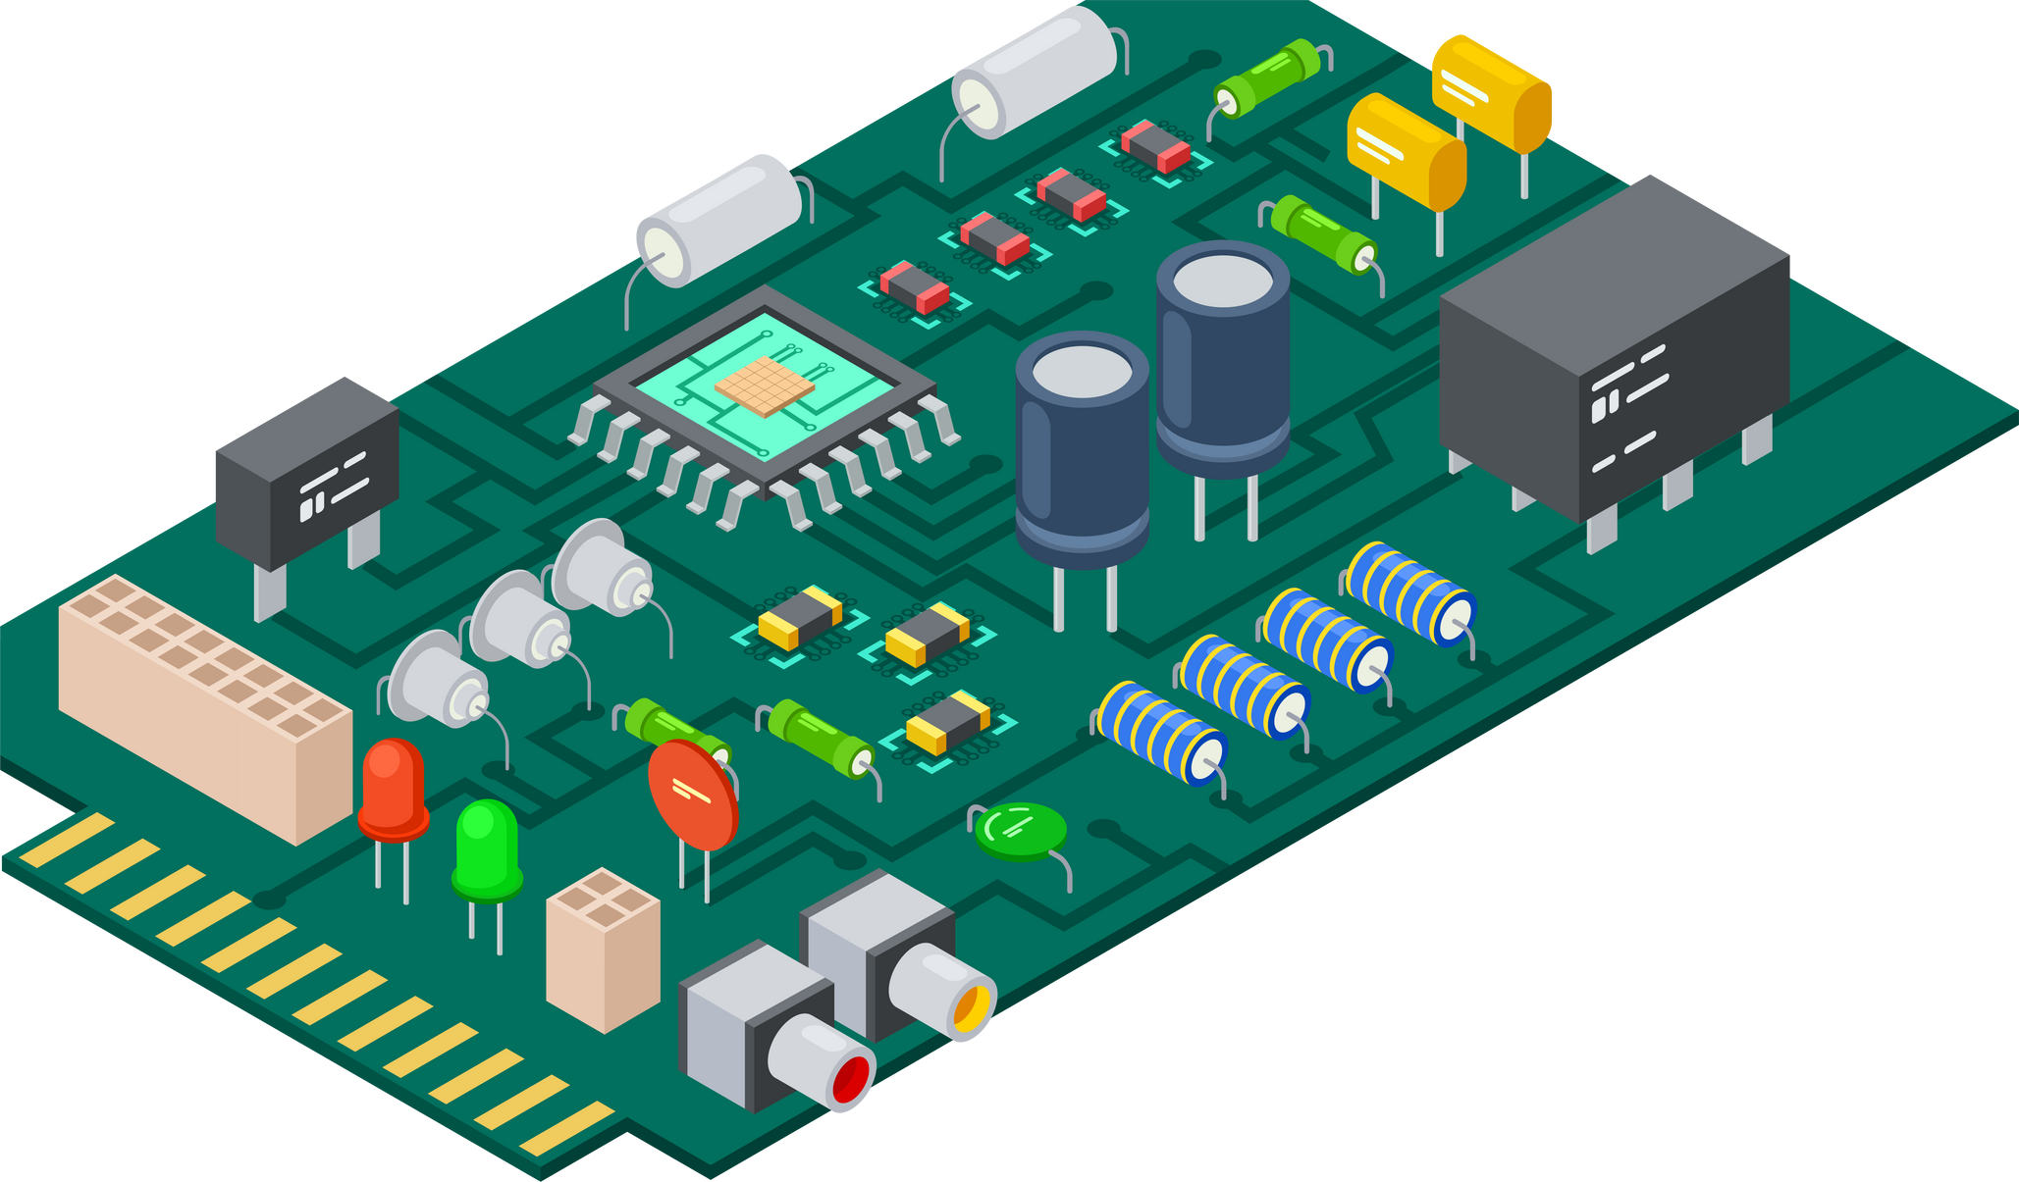
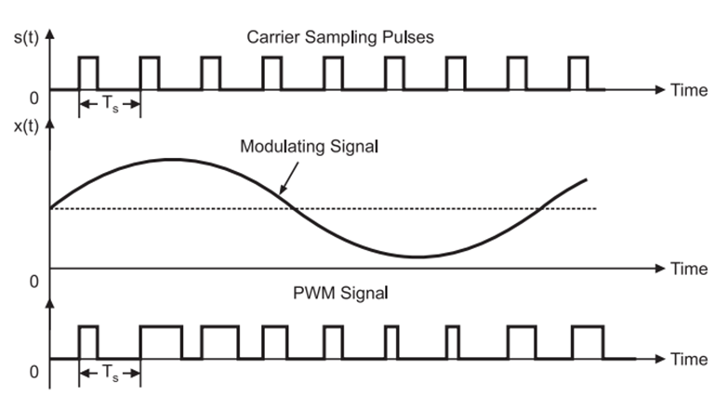
WHAT IS PWM?
In PWM, the width of the modulated pulses varies in proportion with the amplitude of modulating signal. The waveforms of PWM are shown in Figure 2 below.
As we can observe, the amplitude and the frequency of the PWM wave remain constant. Only the width changes. That is why the information is contained in the width variation. This is similar to FM. As the noise is normally additive noise, it changes the amplitude of the PWM signal.
Figure 2
Wave form Representation of PWM

Slide 6

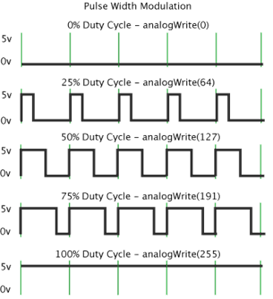
HOW BOUT'
DUTY CYCLE?
The term ‘duty cycle’ describes the proportion of 'on' time to the regular interval or 'period' of time; a low duty cycle corresponds to low power, because the power is off for most of the time.
The duty cycle is expressed in percent, 100% being fully on. When a digital signal is on half of the time and off the other half of the time, the digital signal has a duty cycle of 50% and resembles a "square" wave. When a digital signal spends more time in the on state than the off state, it has a duty cycle of >50%. Figure 3 illustrates these 5 scenarios.
Figure 3
Duty cycle scenarios
Notes:
Giai thich ve duty cycle - on time & off time.

Slide 7



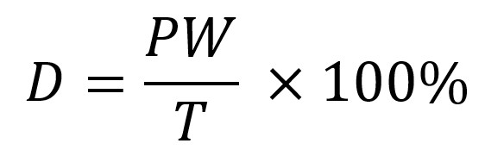
DUTY CYCLE
As a formula, a duty cycle may be expressed as below, where D is the duty cycle, PW is the pulse width (pulse active time), and T is the total period of the signal. Thus, a 60% duty cycle means the signal is on 60% of the time but off 40% of the time. The "on time" for a 60% duty cycle could be a fraction of a second, day, or even a week, depending on the length of the period.
Duty cycle formula

Slide 8


APPLICATION OF PWM
Group 6

Slide 9




Direct Current (DC) motor control in robotics
convey information over a communications channel
Control brightness of an LED light

Slide 10
IMPLEMENTATION
Group 6

Slide 11
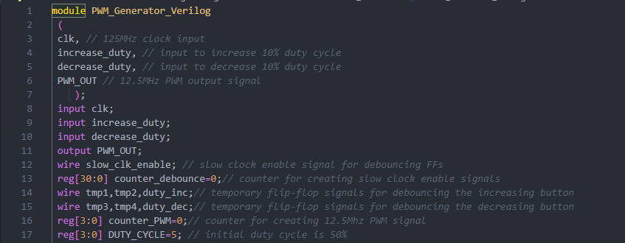
SOURCE CODE

Slide 12
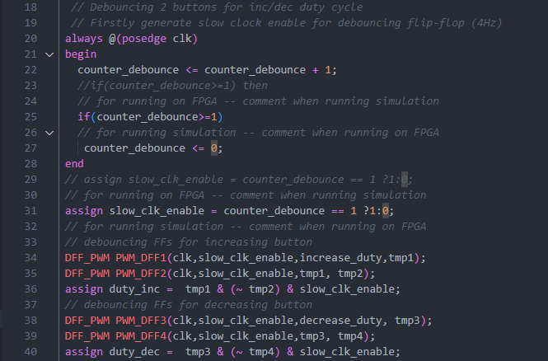
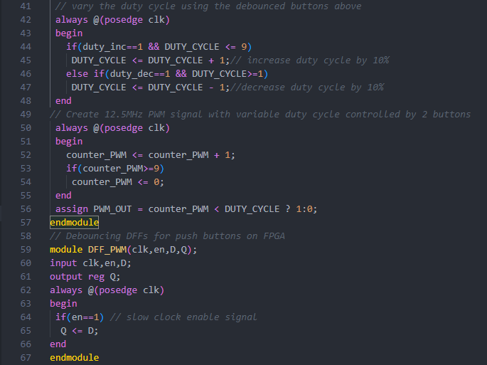
SOURCE CODE

Slide 13


RESULTS
Time resolution: 1ps
Runtime: 1400ns

Slide 14
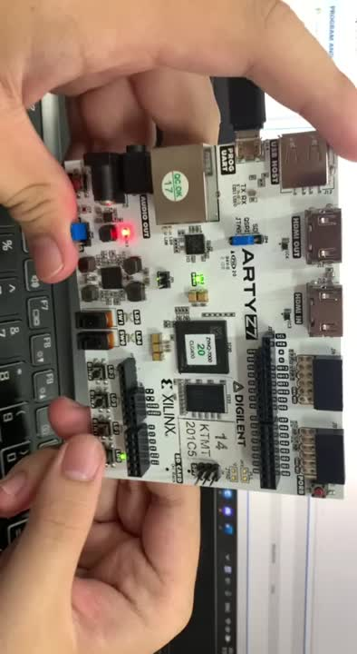
RESULTS
Implement on Arty-Z7

Slide 15

THANK
YOU!
Have a great day ahead.

